Slide 1
Architecture of Enterprise Applications 22 Cloud Computing
Haopeng Chen
REliable, INtelligent and Scalable Systems Group (REINS)
Shanghai Jiao Tong University
Shanghai, China
http://reins.se.sjtu.edu.cn/~chenhp
e-mail: chen-hp@sjtu.edu.cn

Slide 2
Contents and Objectives
Contents
Cloud Computing
Edge Computing
Objectives
能够理解云计算和边缘计算的基础概念和技术栈

Slide 3
What is cloud computing?
There is little consensus on how to define the Cloud
A large-scale distributed computing paradigm that is driven by economies of scale, in which a pool of abstracted, virtualized, dynamically-scalable, managed computing power, storage, platforms, and services are delivered on demand to external customers over the Internet.
In “Cloud Computing and Grid Computing 360-Degree Compared”
Cloud Computing refers to both the applications delivered as services over the Internet and the hardware and systems software in the datacenters that provide those services. The services themselves have long been referred to as Software as a Service (SaaS), so we use that term. The datacenter hardware and software is what we will call a Cloud.
In “Above the Clouds: A Berkeley View of Cloud Computing”

Slide 4
What is cloud computing?
There is little consensus on how to define the Cloud
Cloud computing promises to radically change the way computer applications and services are constructed, delivered, and managed. Although the term means different things to different people, and includes a bit of marketing hype and technical redefinition, the potential benefits are clear. Large datacenters permit resource sharing across hosted applications and lead to economies of scale at both the hardware and software level. Software services can obtain seemingly infinite scalability and incremental growth to meet customers’ elastic demands. The pay-as-you-go model and rapid provisioning can result in more efficient resource utilization and reduced costs.
On “Introduction to Cloud Computing - ACM Tech pack Committee on CC”

Slide 5
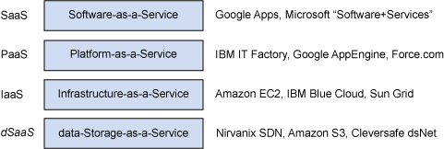






What is cloud computing?
Cloud in the real world
Cloud as reality, as told by industry partners

Slide 6
What is cloud computing?
Cloud in the real world
Cloud is different in many dimensions
Time to deploy a server
Weeks or months -> seconds to minutes
Commitment to use service
Negotiate & commit year long contract -> select from catalog & Pay as you go
Necessary upfront investment
$M -> $K
Common attributes of clouds
Flexible pricing
Elastic scaling
Rapid provisioning
Advanced virtualization

Slide 7

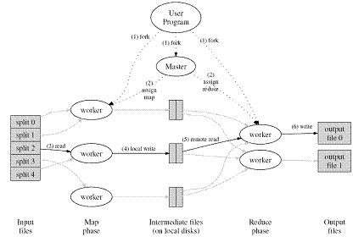
Core techniques of cloud computing
MapReduce
parallelizes the computation, distributes the data, and handles failures conspire to obscure the original simple computation with large amounts of complex code to deal with these issues.

Slide 8
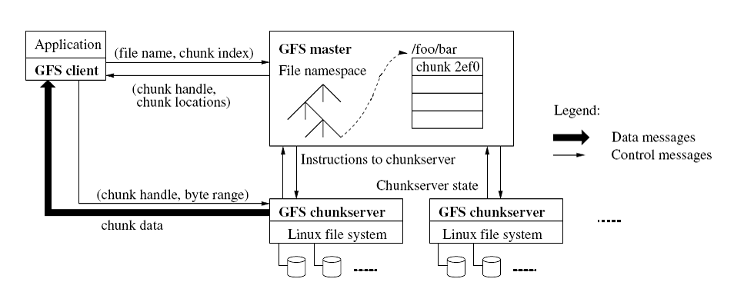
Core techniques of cloud computing
Distributed Google File System
Google File System(GFS) to meet the rapidly growing demands of Google’s data processing needs.

Slide 9
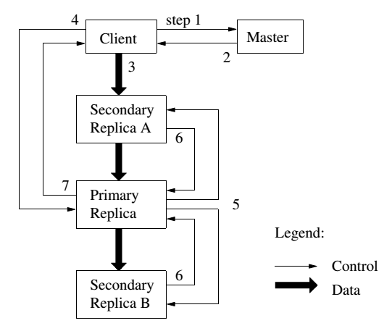
GFS
Write Control and Data Flow

Slide 10
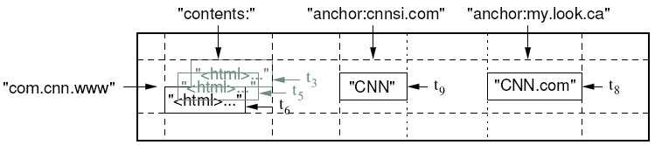
Core techniques of cloud computing
Bigtable
Bigtable is a distributed storage system for managing structured data that is designed to scale to a very large size: petabytes of data across thousands of commodity servers.

Slide 11
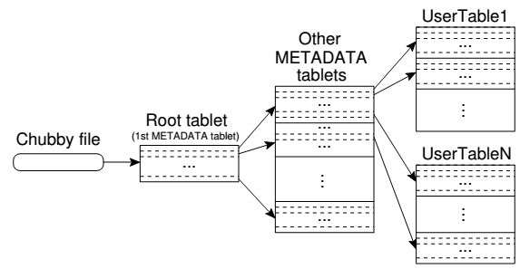
Bigtable
A Bigtable is a sparse, distributed, persistent multidimensional sorted map.
The map is indexed by a row key , column key , and a timestamp; each value in the map is an uninterpreted array of bytes.

Slide 12
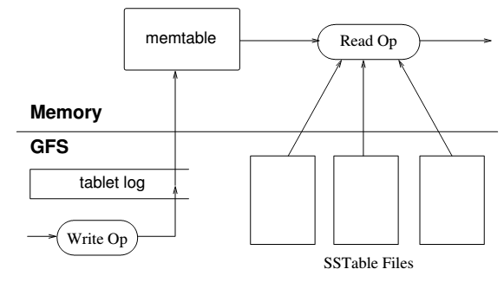
Bigtable
The persistent state of a tablet is stored in GFS.
Updates are committed to a commit log that stores redo records.
Of these updates, the recently committed ones are stored in memory in a sorted buffer called a memtable; the older updates are stored in a sequence of SSTables.

Slide 13

Core techniques of cloud computing
The Apache Hadoop project develops open-source software for reliable, scalable, distributed computing. Hadoop includes these subprojects:
Hadoop Common: The common utilities that support the other Hadoop subprojects.
HDFS: A distributed file system that provides high throughput access to application data.
MapReduce: A software framework for distributed processing of large data sets on compute clusters.
IBM, Amazon, Yahoo
Base stone

Slide 14
What is Edge Computing ?
Edge computing
is a method of optimizing cloud computing systems by performing data processing at the edge of the network, near the source of the data.

Slide 15
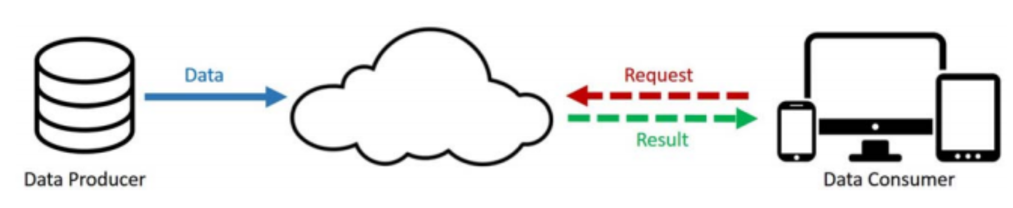
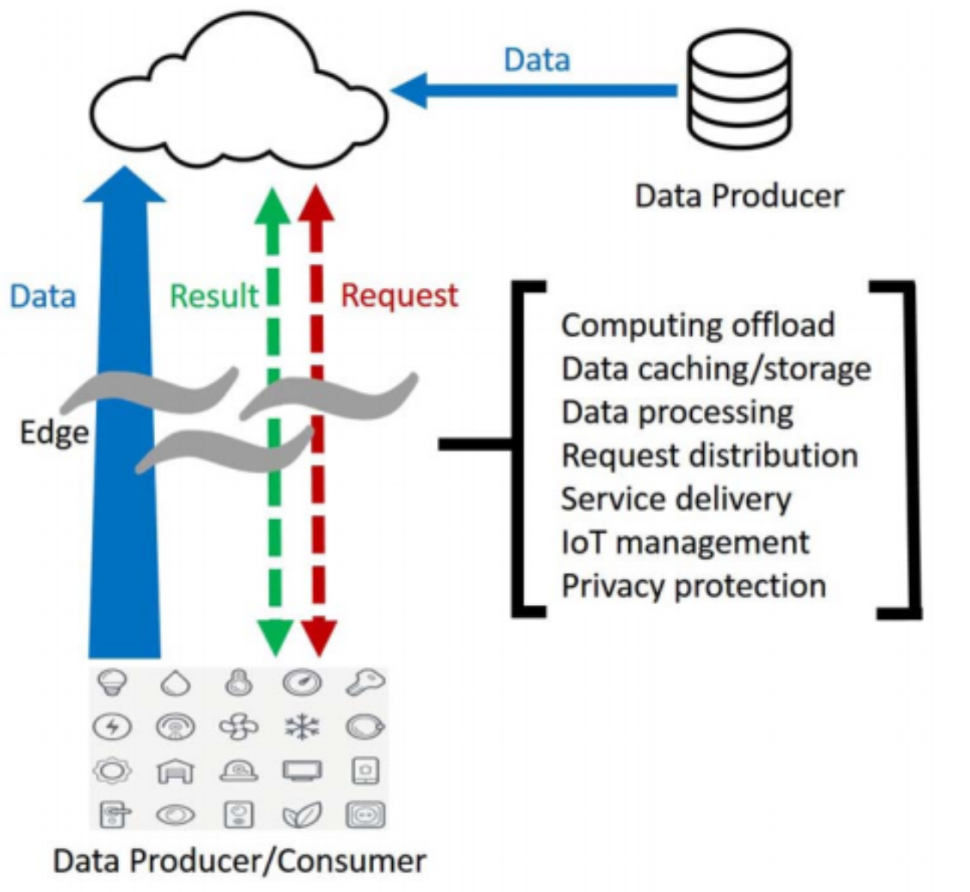
What is Edge Computing ?
Cloud computing
Edge computing

Slide 16
What is Edge Computing ?
Edge Computing
This reduces the communications bandwidth needed between sensors and the central data center by performing analytics and knowledge generation at or near the source of the data.
This approach requires leveraging resources that may not be continuously connected to a network such as laptops, smartphones, tablets and sensors

Slide 17
Application Scenario
Cloud offloading
In the cloud computing paradigm, most of the computations happen in the cloud, which means data and requests are processed in the centralized cloud.
In the edge computing paradigm, not only data but also operations applied on the data should be cached at the edge.
Challenges:
The data at the edge node should be synchronized with the cloud
Another issue involves the collaboration of multiple edges when a user moves from one edge node to another

Slide 18
Application Scenario
Video Analytics
Cloud computing is no longer suitable for applications that requires video analytics due to the long data transmission latency and privacy concerns.
With the edge computing paradigm, the request can be generated from the cloud and pushed to all the things in a target area. Each thing, for example, a smart phone, can perform the request and search its local camera data and only report the result back to the cloud.
In this paradigm, it is possible to leverage the data and computing power on every thing and get the result much faster compared with solitary cloud computing.

Slide 19
Application Scenario
Smart Home
Smart home would report an impressive amount of data and for the consideration of data transportation pressure and privacy protection, this data should be mostly consumed in the home.
This feature makes the cloud computing paradigm unsuitable for a smart home.
Edge computing is considered perfect for building a smart home:
with an edge gateway running a specialized edge operating system (edgeOS) in the home,
the things can be connected and managed easily in the home,
the data can be processed locally to release the burdens for Internet bandwidth,
and the service can also be deployed on the edgeOS for better management and delivery.

Slide 20
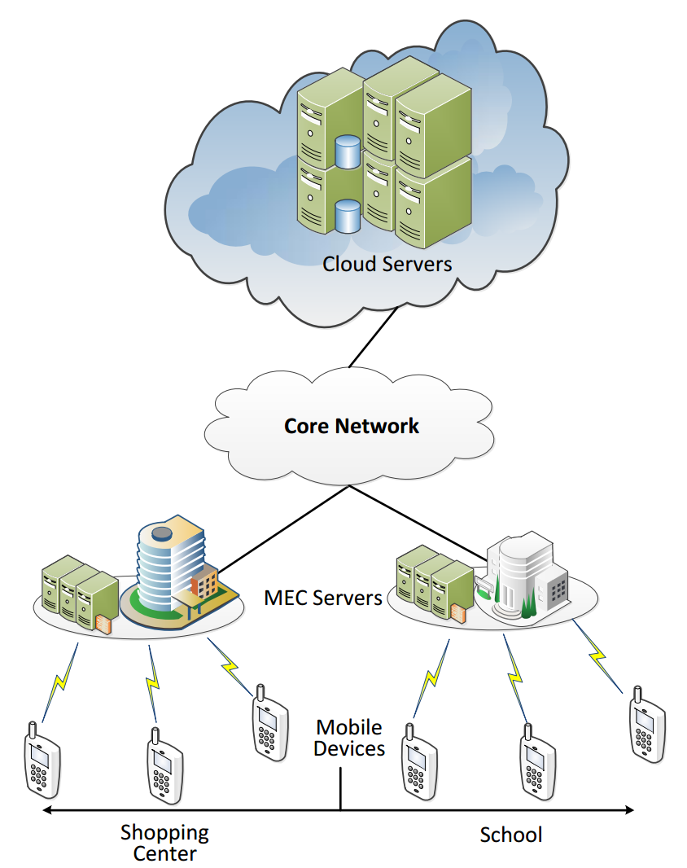
Edge Computing
The Rise of Cloud-Terminal Fusion Computing
Cloud Servers
Mobile Edge Computing Servers
Mobile Devices (Edge Devices)

Slide 21
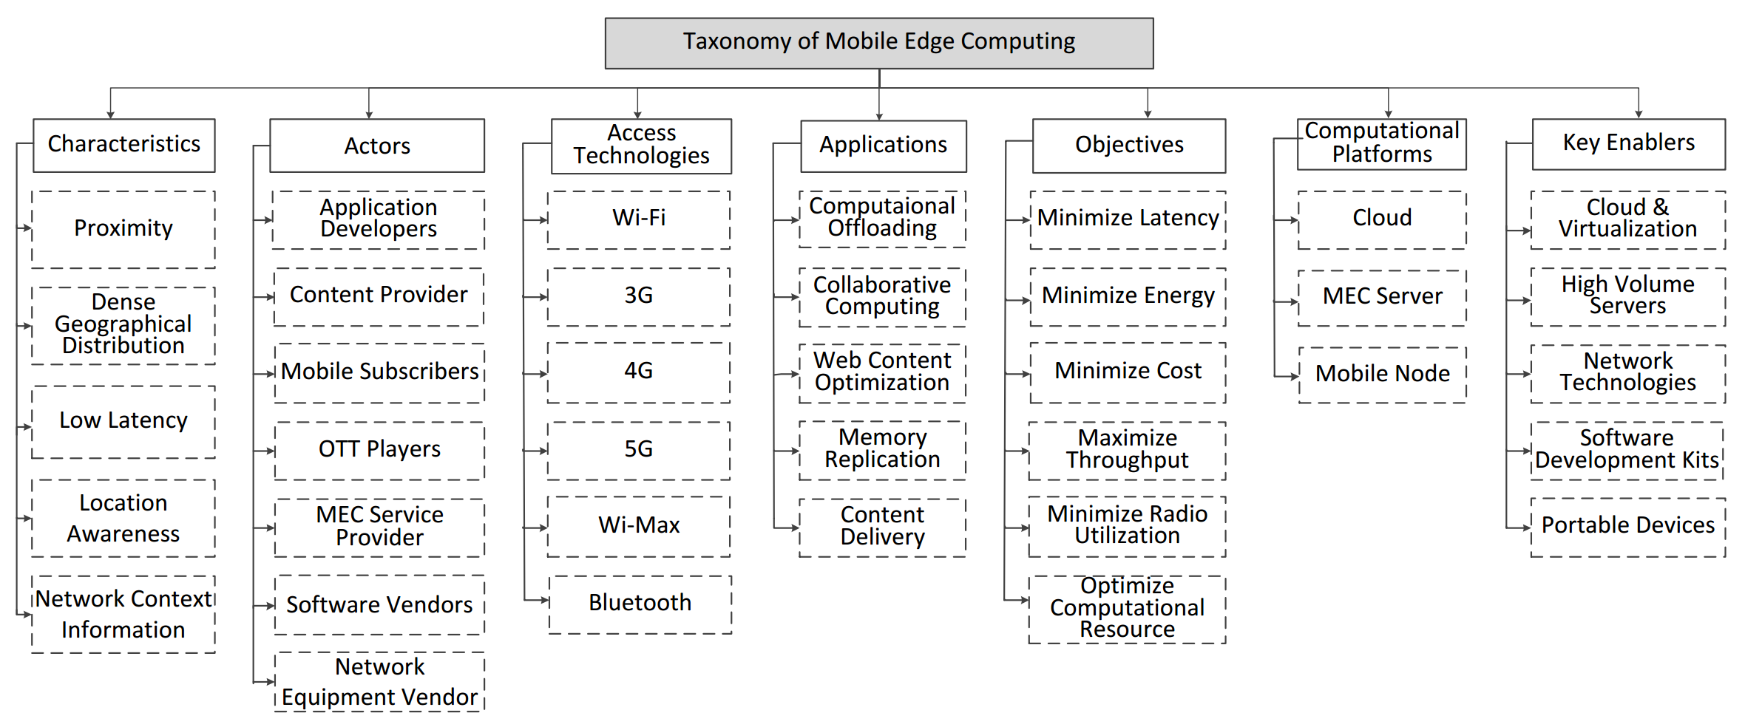
Taxonomy of Mobile Edge Computing

Slide 22
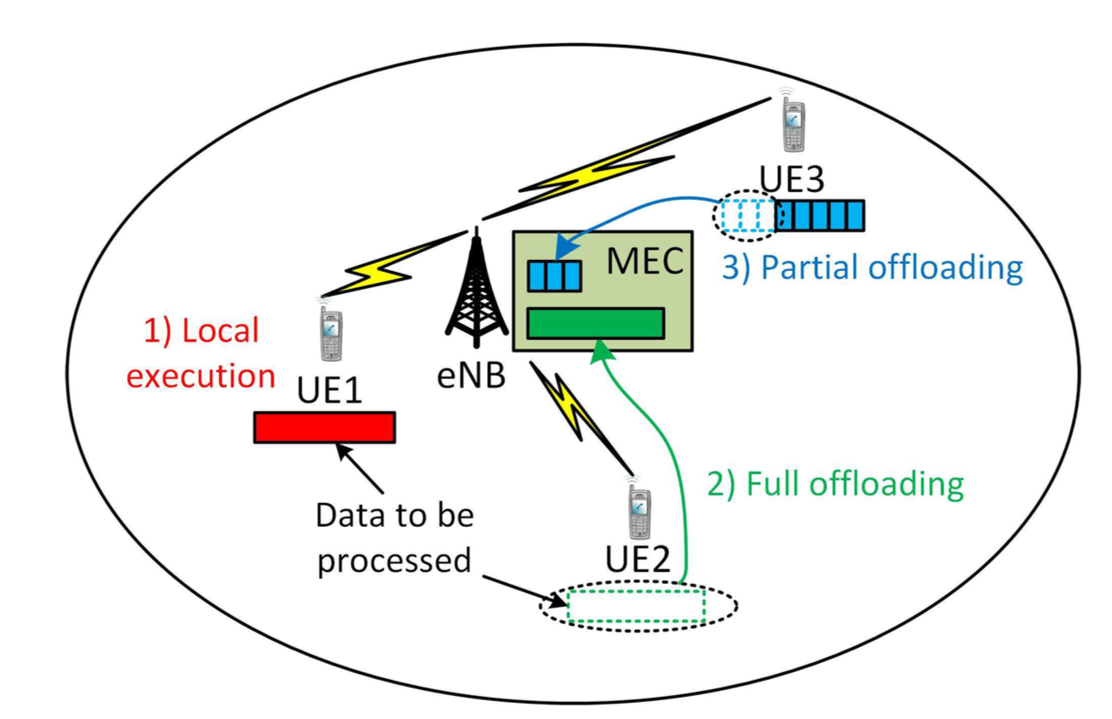
Computation Offloading
From the user perspective,
a critical use case regarding the MEC is a computation offloading as this can save energy and/or speed up the process of computation.
Local Execution
Full offloading
Partial offloading

Slide 23
Architecture of Enterprise Applications 22 GraphQL
Haopeng Chen
REliable, INtelligent and Scalable Systems Group (REINS)
Shanghai Jiao Tong University
Shanghai, China
http://reins.se.sjtu.edu.cn/~chenhp
e-mail: chen-hp@sjtu.edu.cn

Slide 24
Contents and Objectives
Contents
GraphQL
Objectives
能够掌握GraphQL编程模型

Slide 25

GraphQL
A query language for your API
GraphQL is a query language for APIs and a runtime for fulfilling those queries with your existing data.
GraphQL provides a complete and understandable description of the data in your API, gives clients the power to ask for exactly what they need and nothing more, makes it easier to evolve APIs over time, and enables powerful developer tools.
https://graphql.org/

Slide 26
GraphQL
GraphQL is a query language for your API, and a server-side runtime for executing queries using a type system you define for your data.
GraphQL isn't tied to any specific database or storage engine and is instead backed by your existing code and data.
A GraphQL service is created by defining types and fields on those types, then providing functions for each field on each type.
type Query {
me: User
}
type User {
id: ID
name: String
}
function Query_me(request) {
return request.auth.user
}
function User_name(user) {
return user.getName()
}

Slide 27
GraphQL
After a GraphQL service is running (typically at a URL on a web service),
it can receive GraphQL queries to validate and execute.
The service first checks a query to ensure it only refers to the types and fields defined, and then runs the provided functions to produce a result.
{
me {
name
}
}
{
"me": {
"name": "Luke Skywalker"
}
}

Slide 28
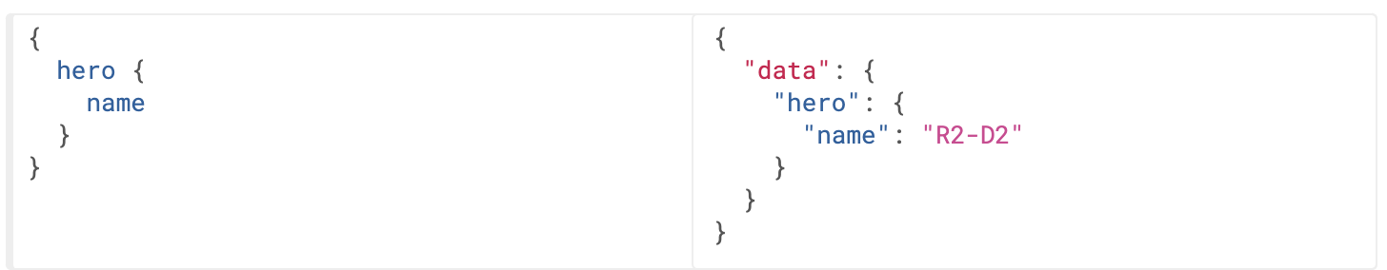
Queries and Mutations
Fields
At its simplest, GraphQL is about asking for specific fields on objects.

Slide 29
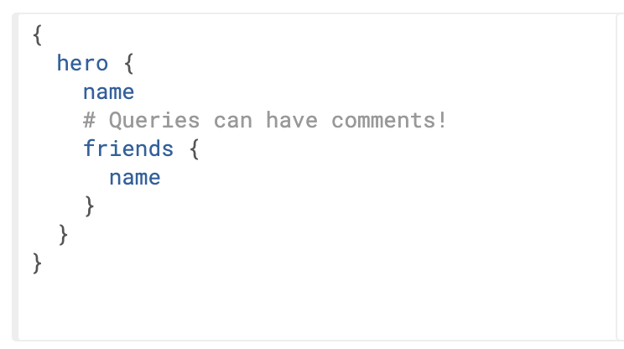
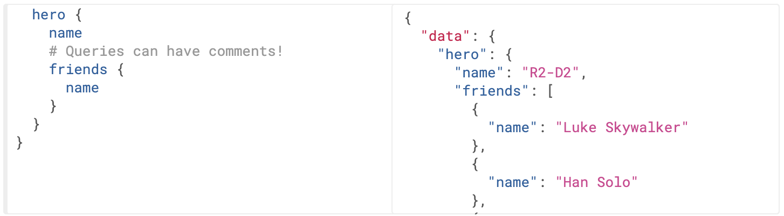
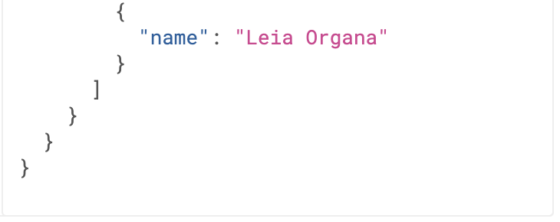
Queries and Mutations
Fields
GraphQL queries can traverse related objects and their fields, letting clients fetch lots of related data in one request, instead of making several roundtrips as one would need in a classic REST architecture.

Slide 30
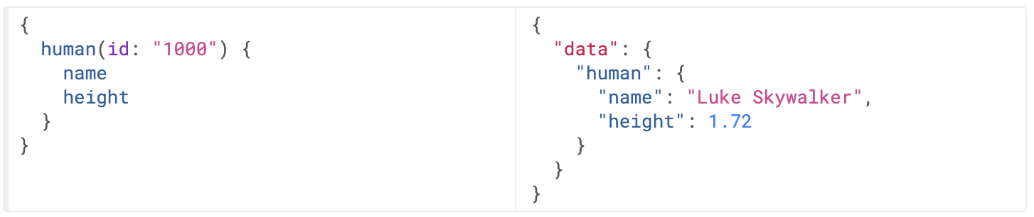
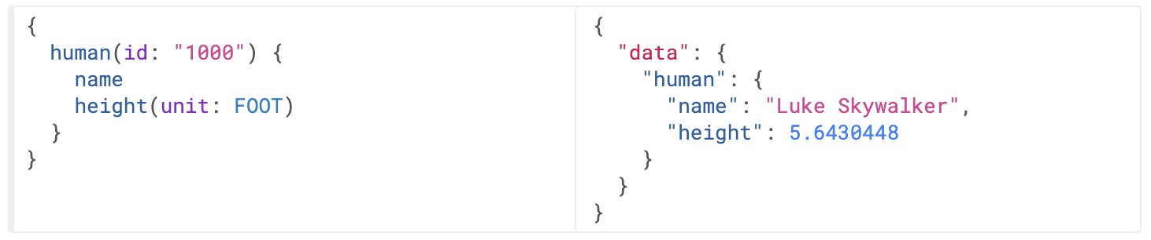
Queries and Mutations
Arguments
in GraphQL, every field and nested object can get its own set of arguments, making GraphQL a complete replacement for making multiple API fetches.

Slide 31
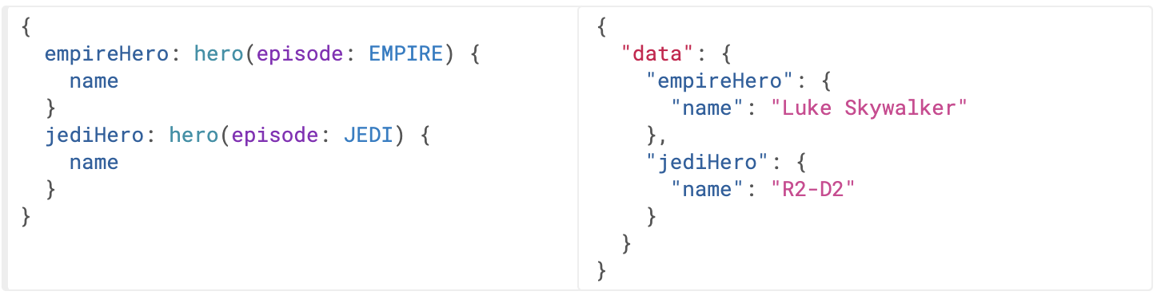
Queries and Mutations
Aliases
The two hero fields would have conflicted, but since we can alias them to different names, we can get both results in one request.

Slide 32
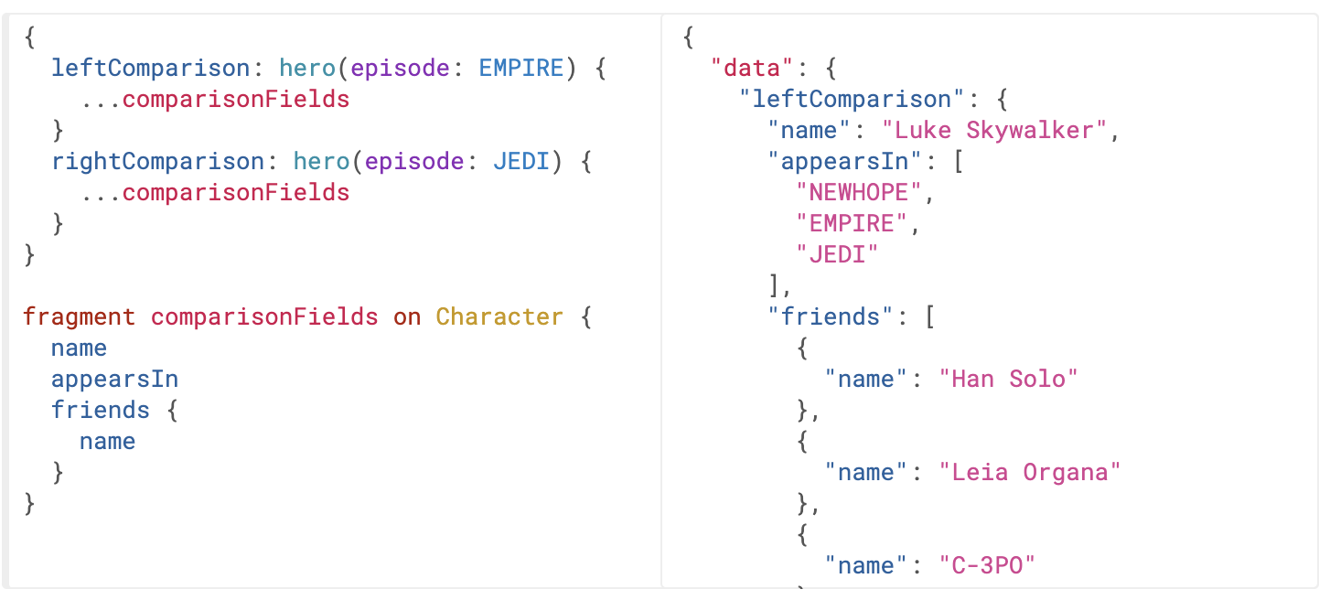
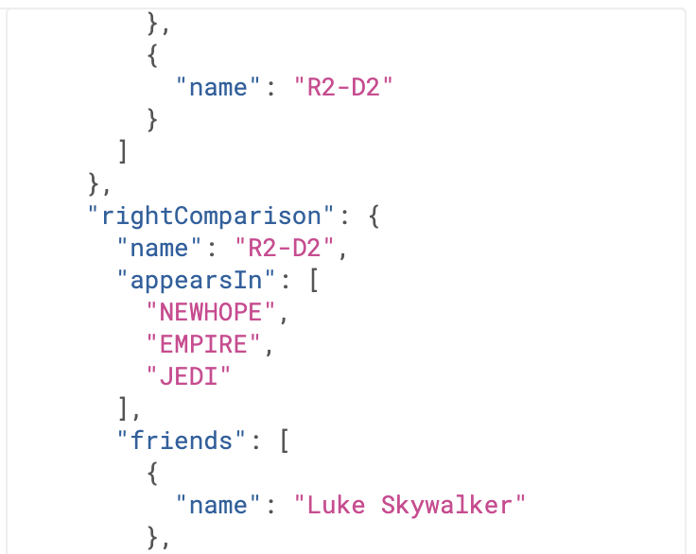
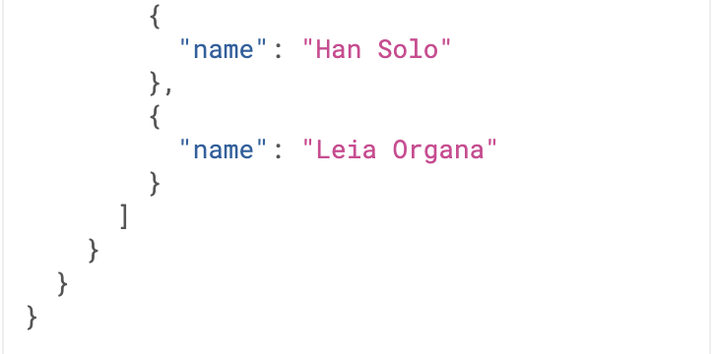
Queries and Mutations
Fragments
Fragments let you construct sets of fields, and then include them in queries where you need to.

Slide 33
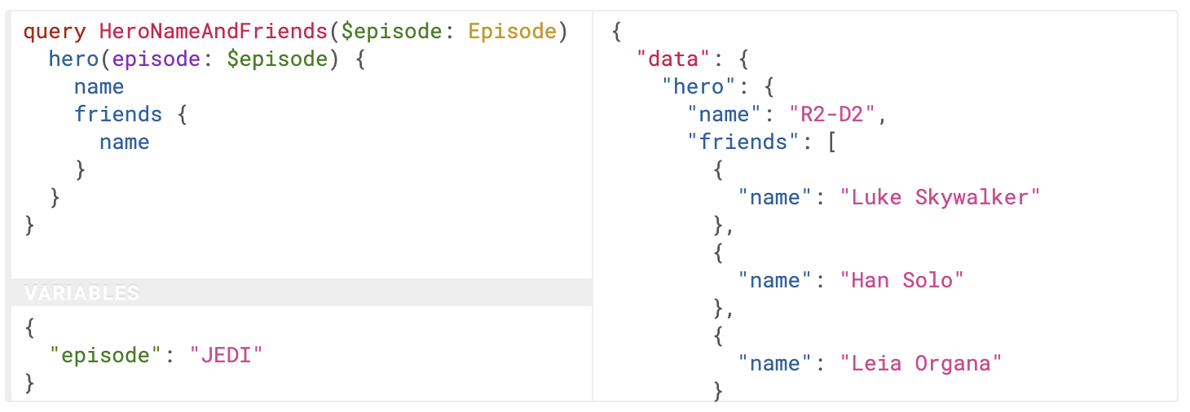
Queries and Mutations
Variables
GraphQL has a first-class way to factor dynamic values out of the query, and pass them as a separate dictionary. These values are called variables.

Slide 34
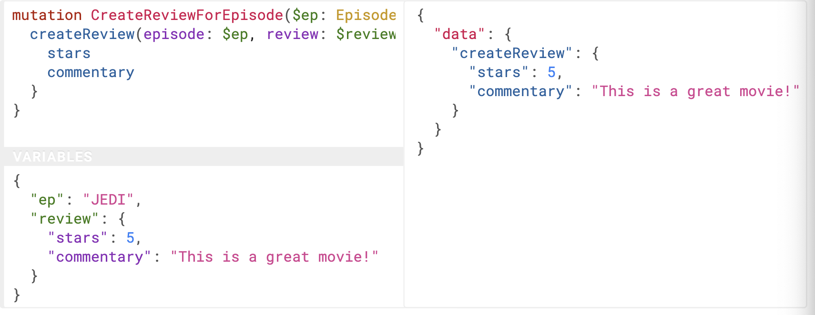
Queries and Mutations
Mutations
GraphQL is similar - technically any query could be implemented to cause a data write.
Note how createReview field returns the stars and commentary fields of the newly created review.

Slide 35
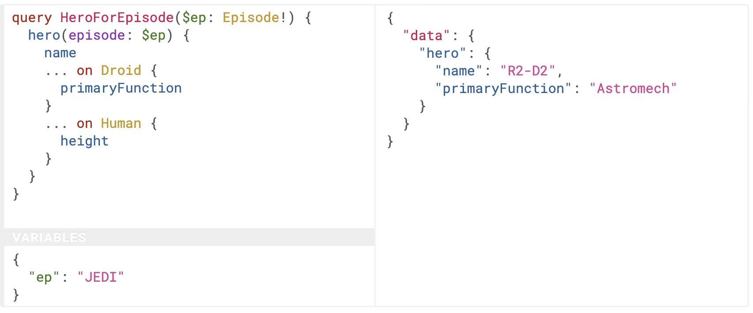
Queries and Mutations
Inline Fragments
If you are querying a field that returns an interface or a union type, you will need to use inline fragments to access data on the underlying concrete type.

Slide 36
Getting started with Spring for GraphQL
Spring for GraphQL and Spring Web.
<dependency> <groupId>org.springframework.boot</groupId> <artifactId>spring-boot-starter-graphql</artifactId> </dependency> <dependency> <groupId>org.springframework.boot</groupId> <artifactId>spring-boot-starter-web</artifactId> </dependency>

Slide 37
Getting started with Spring for GraphQL
Query.graphql
query bookDetails { bookById(id: "book-1") { id name pageCount author { firstName lastName } } }

Slide 38
Getting started with Spring for GraphQL
Response in JSON
{
"bookById "
: { "id":"book-1",
"name":"Effective Java",
"pageCount":416,
"author": {
"firstName":"Joshua",
"lastName":"Bloch"
}
} }

Slide 39
Getting started with Spring for GraphQL
Schema.graphql
type Query {
bookById(id: ID): Book
}
type Book {
id: ID
name: String
pageCount: Int
author: Author
}
type Author {
id: ID
firstName: String
lastName: String
}

Slide 40
Getting started with Spring for GraphQL
Book.java
public record Book (String id, String name, int pageCount, String authorId) { private static List<Book> books = Arrays.asList( new Book("book-1", "Effective Java", 416, "author-1"), new Book("book-2", "Hitchhiker's Guide to the Galaxy", 208, "author-2"), new Book("book-3", "Down Under", 436, "author-3") ); public static Book getById(String id) { return books.stream() .filter(book -> book.id().equals(id)) .findFirst() .orElse(null); } }

Slide 41
Getting started with Spring for GraphQL
Author.java
public record Author (String id, String firstName, String lastName) { private static List<Author> authors = Arrays.asList( new Author("author-1", "Joshua", "Bloch"), new Author("author-2", "Douglas", "Adams"), new Author("author-3", "Bill", "Bryson") ); public static Author getById(String id) { return authors.stream() .filter(author -> author.id().equals(id)) .findFirst() .orElse(null); } }

Slide 42
Getting started with Spring for GraphQL
BookController.java
@Controller public class BookController { @QueryMapping public Book bookById(@Argument String id) { return Book.getById(id); } @SchemaMapping public Author author(Book book) { return Author.getById(book.authorId()); } }

Slide 43
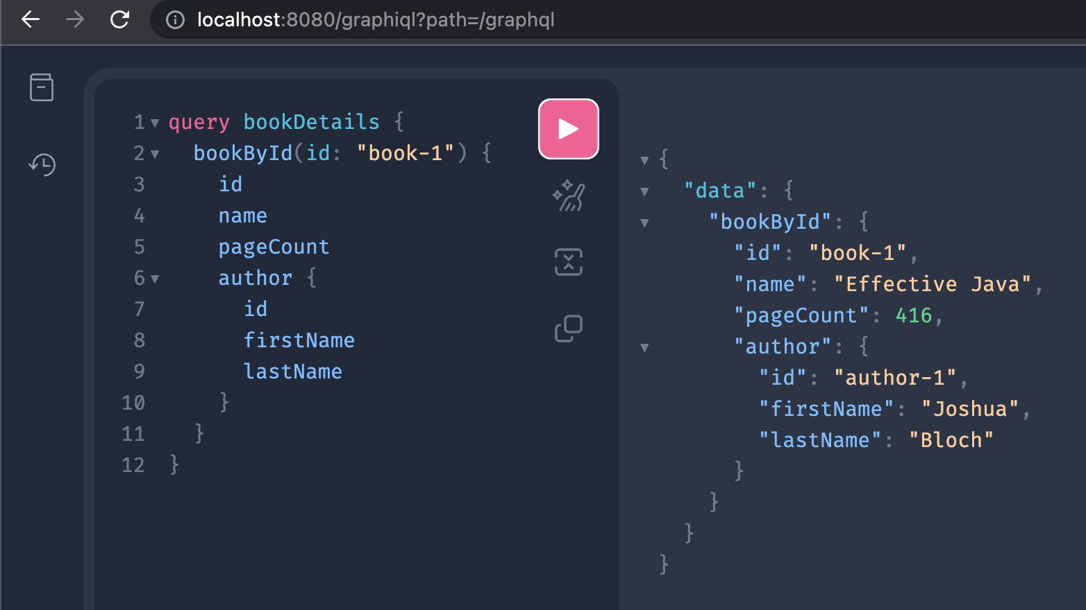
Getting started with Spring for GraphQL
http://localhost:8080/graphiql

Slide 44
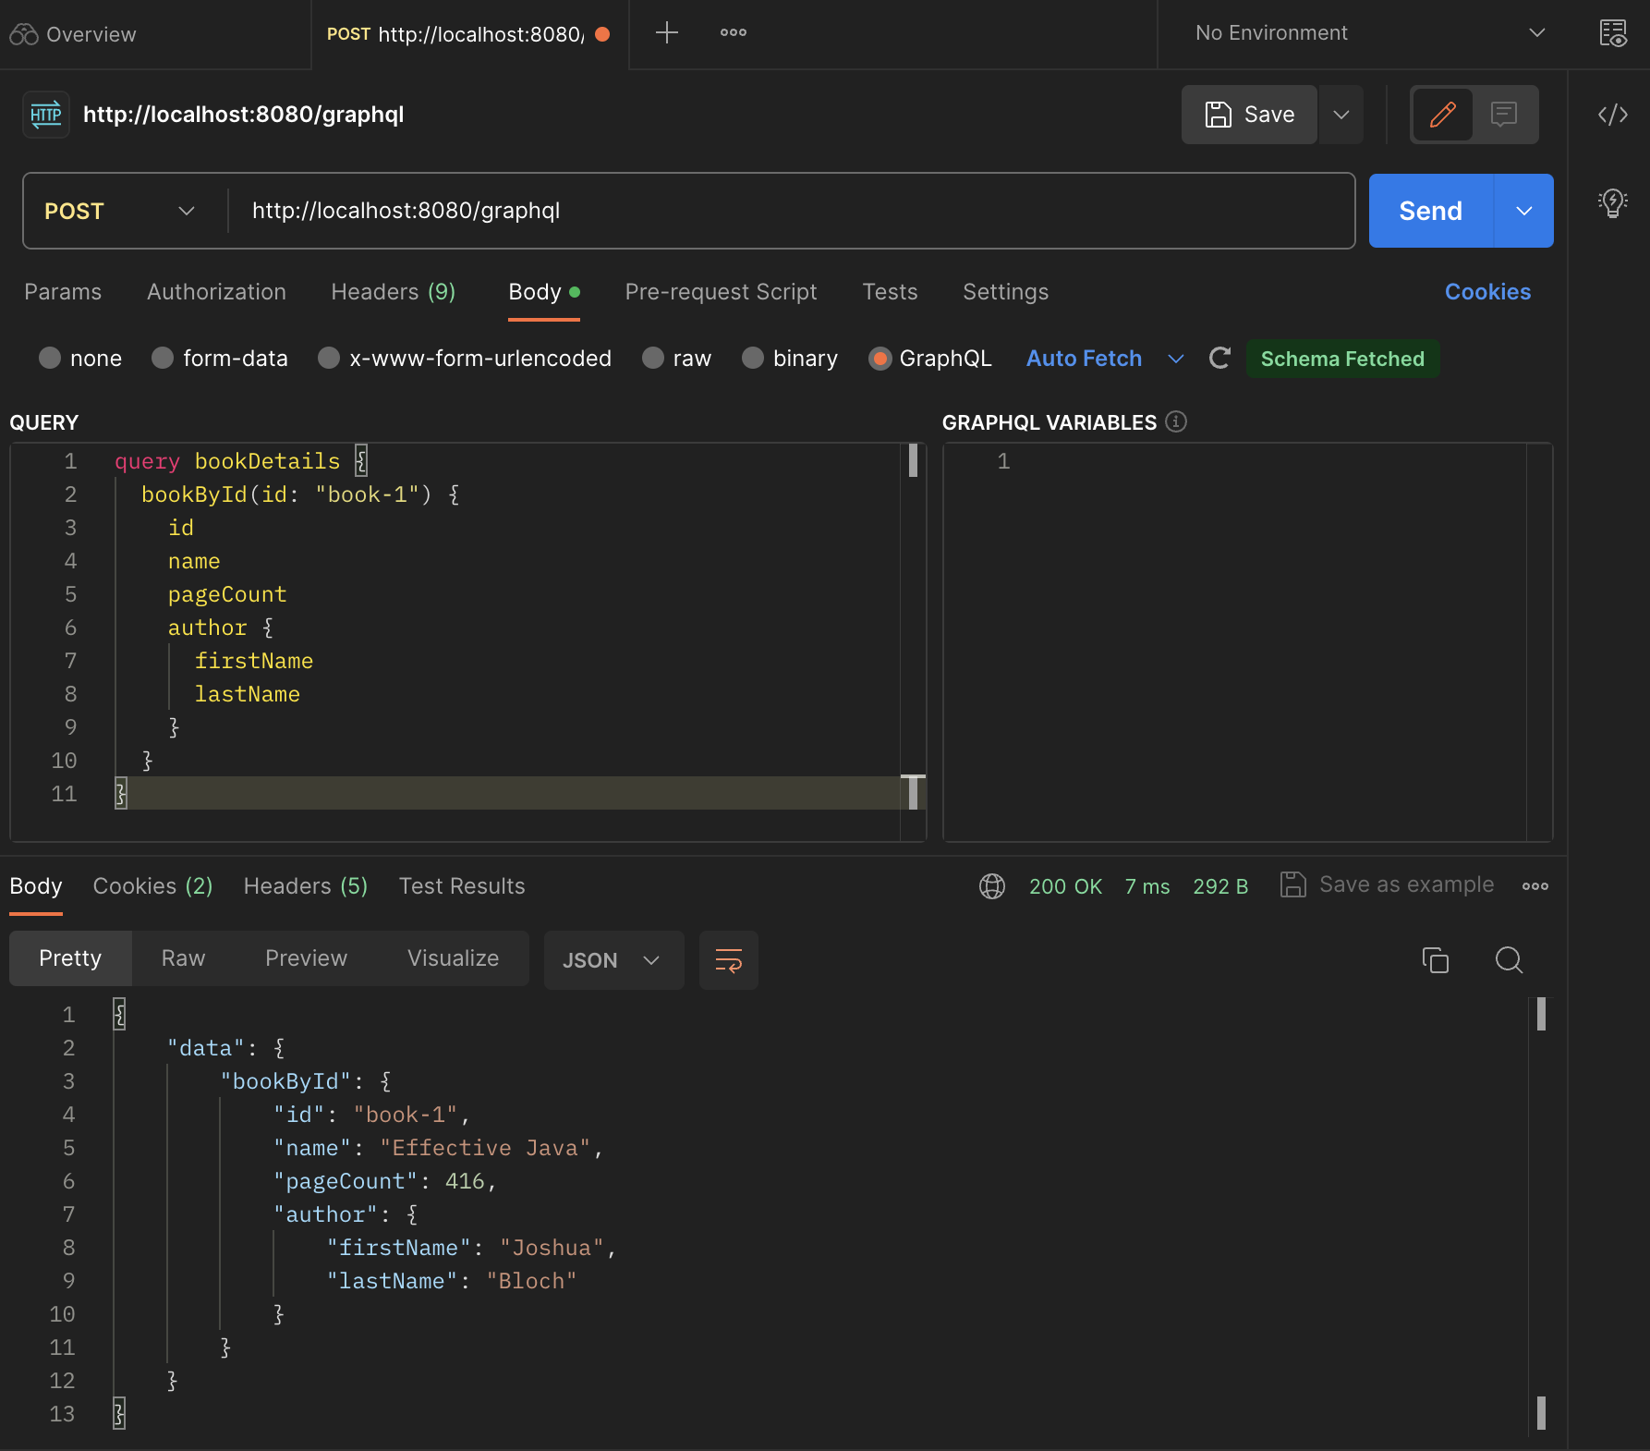
Sending GraphQL via Postman

Slide 45
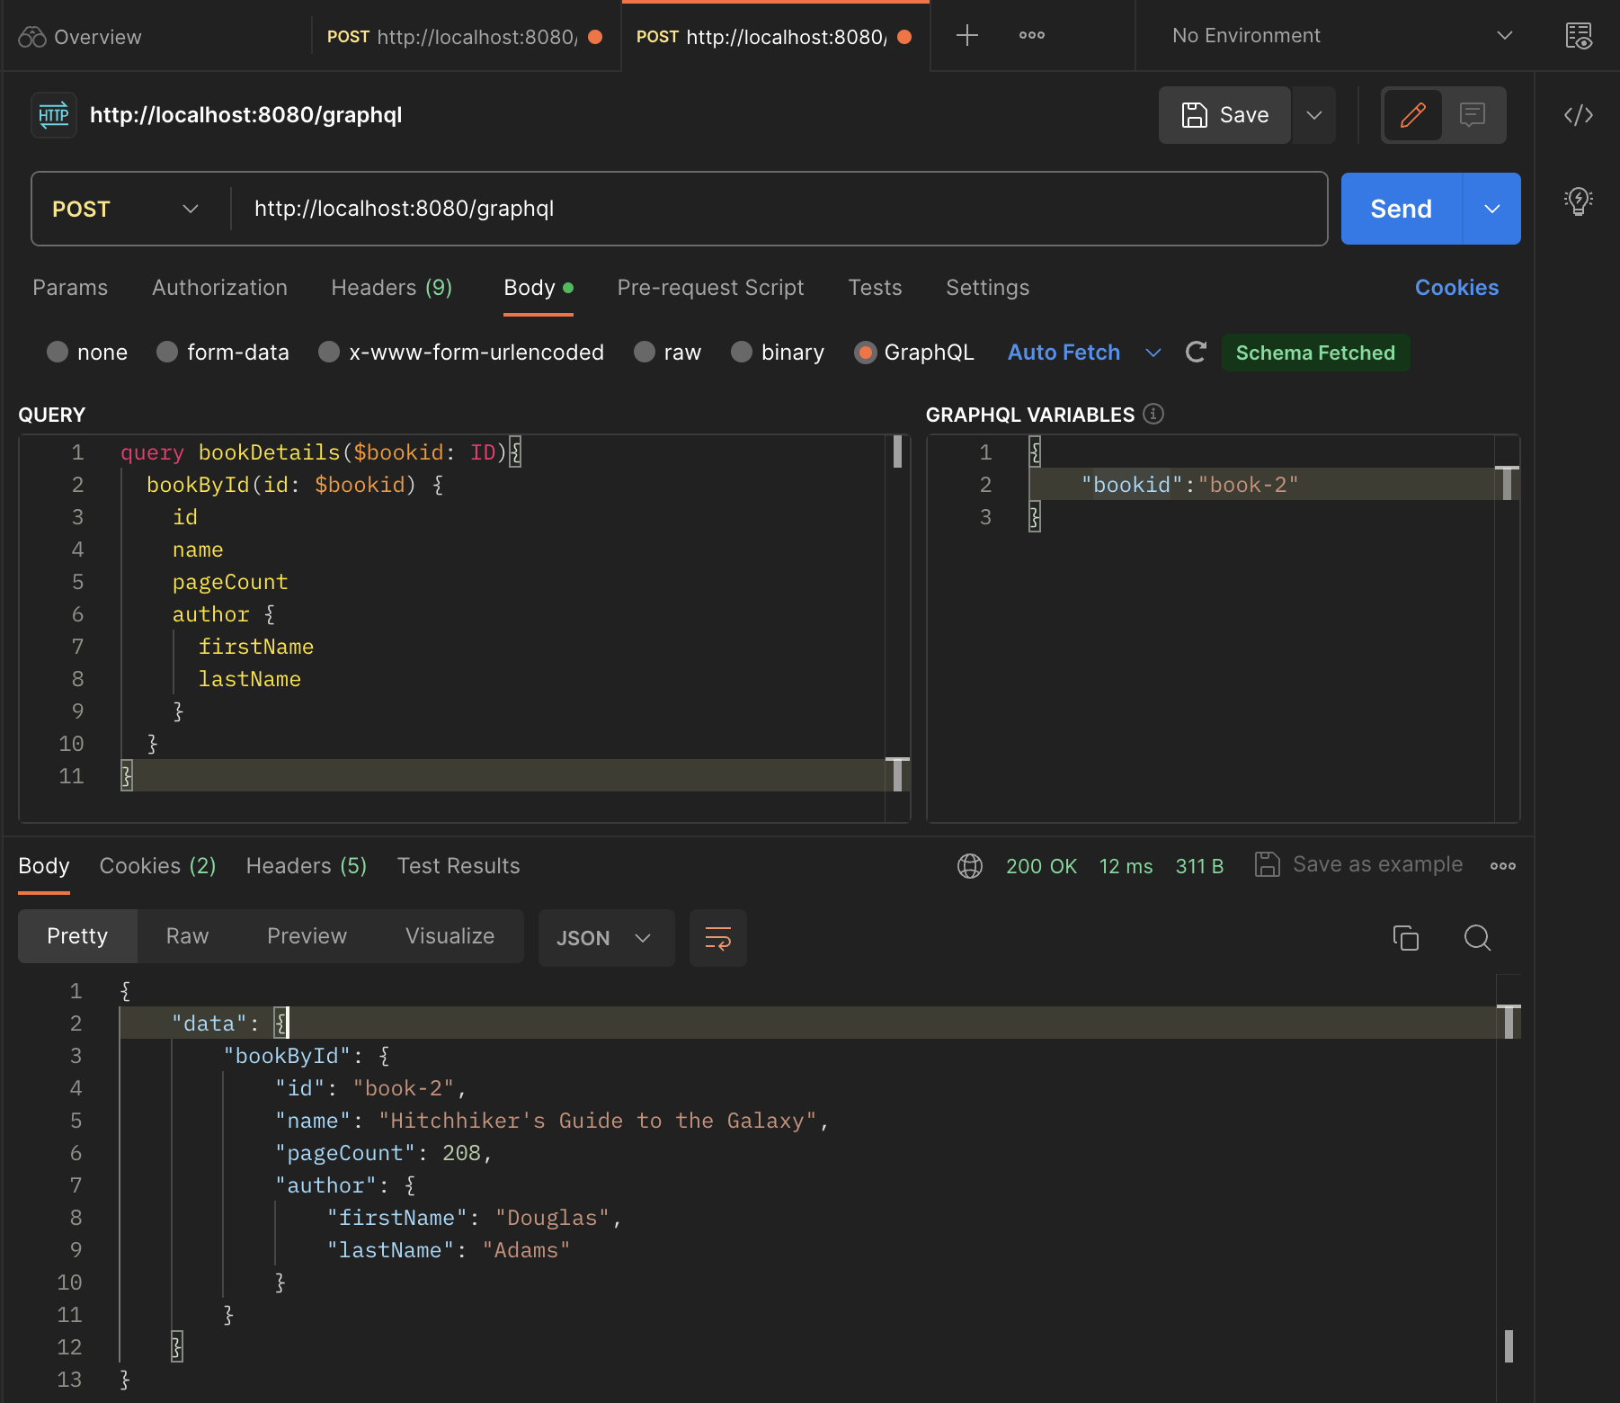
Sending GraphQL via Postman

Slide 46
References
GraphQL
https://graphql.org/
Building a GraphQL service
https://spring.io/guides/gs/graphql-server/
Postman使用 GraphQL 查询
https://postman.org.cn/sending-requests/supported-api-frameworks/graphql/

Slide 47

Thank You!

